Slide 1
Car Rental System
GROUP MEMBERS:
Sumit Katiyar (IIT2019110)
Anurag Bandopadhyay (IIT2019126)
Rahul Kumar (IIT2019109)
Aditya Singh Machhaiya (IIT2019111)
Nandini Gupta (IIT2019149)
Instructor : Dr. Sonali Agarwal

Slide 2
Problem Statement
>>To design an automated and responsive web application that caters to the needs of customers looking to rent a car online for their personal purposes keeping in mind the non functional requirements like user friendly UI, responsiveness, and security.

Slide 3
Introduction
A rental service is a service where customers arrive to request the hire of a rental unit. It is more convenient than carrying the cost of owning and maintaining the unit. A car rental company is a company that rents automobiles for a short period of time and charges a fee for the particular period of time on an hourly basis or daily basis.
It is more convenient to book the cars online rather than using the traditional manual system of vehicle reservation. This eliminates the risk of erroneous booking, saves time, and ensures growth in customer satisfaction. They can book any car according to their brands and price.

Slide 4
Introduction
Car rental, or hire a car facility, refers to the process of renting a car for a short duration. These car rental services are provided by agencies that purchase several fleet. vehicles and rent them to customers for a fee. Nowadays, individuals prefer to hire a car on rent as it is a more cost-effective alternative than owning a vehicle and offers freedom of movement and low-cost traveling. Some rental cars are also equipped with entertainment systems, global positioning systems (GPS), and Wi-Fi networks.

Slide 5
Introduction
Significant growth in the travel and tourism industry across the globe is one of the key factors driving the growth of the car rental industry. Furthermore, the rising urban population with increasing inclination toward adventure and travel is also providing a boost to the market growth. In line with this, individuals are adopting car rental services in the form of taxis and carpooling for increased mobility and cost-effective traveling.
The implementation of favorable government policies, along with the increasing awareness regarding environment conservation, is acting as another growth-inducing factor. Governments of both the developed and emerging economies are emphasizing on minimizing their vehicular emissions and promoting car rental services as one of the most economical modes of transportation. Other factors, including the introduction of car rental services through websites and smartphone-based applications, coupled with increasing expenditure capacities of the masses, are expected to drive the market further.

Slide 6
Product Scope
The global car rental market is primarily driven by the rapid growth of the information technology (IT) sector. With the rising demand of smartphones, renting a car through online platforms has become the most preferred choice. Besides this, increased travel and tourism activities have encouraged individuals to opt for car rental services, such as taxis and carpooling, for improved mobility and cost-effective traveling. The high usage rate of car rental services by daily commuters and office goers is also providing a positive outlook to the market. Besides this, governments of various countries are emphasizing on minimizing their vehicular emissions. Consequently, car rental services have emerged as one of the most economical modes of transportation.

Slide 7
Product Scope
This project traverses a lot of areas ranging from business concept to computing field, and required to perform several researches to be able to achieve the project objectives. The area covers include:
Car rental industry: This includes study on how the car rental business is being done, process involved and opportunity that exist for improvement.
PHP Technology used for the development of the application. General customers as well as the company’s staff will be able to use the system effectively.
Web-platform means that the system will be available for access 24/7 except when there is a temporary server issue which is expected to be minimal.

Slide 8
Competitive Landscape
The global car rental industry is highly fragmented with the presence of several small and large players. Some of the major players in the market are:
Avis Budget Group, Inc.
Carzonrent India Private Limited
Eco rent a car
Sixt SE
Localiza
Enterprise Holdings, Inc.
Enterprise Rent-A-Car
Europcar
The Hertz Corporation
Turo

Slide 9
Motivation and Objective
The objective of the project is to automate car rental and reservation so that customers can book a car from the comfort of their home and thus save time.
To transform the manual process of hiring car to a computerized system.
To validate the Rental car system using user satisfaction test.
To produce the documentation such as Software Requirement Specification(SRS), Software Design Specification(SDS) as system development reference

Slide 10
Methodology/Procedure
For the development of the project the designing of the database was done on PHPMYADMIN, back end was coded in basic PHP and for frontend we used the same basic PHP codes.
Software methodologies are concerned with the process of creating software –majorly on the organizational aspects. Several software development approaches have been used since the origin of Information Technology. In this project we have implemented the Waterfall model of Software Development Life Cycle (SDLC)

Slide 11
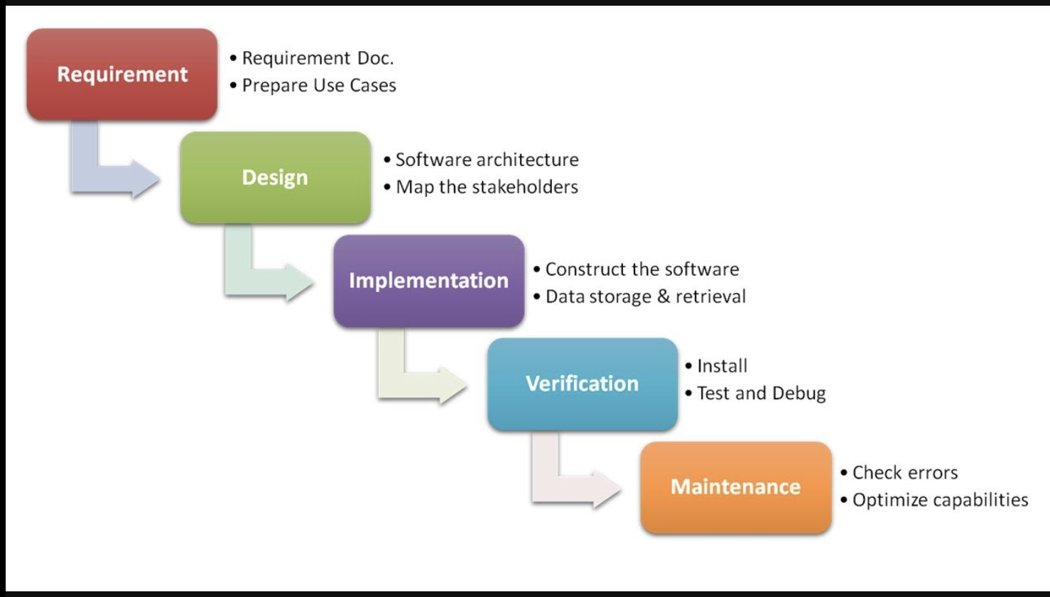
SDLC(Software Development Life Cycle) - Waterfall Model

Slide 12
Tools Used
Xampp:
Apache:
(Application Server) Apache , often referred to as Server, is an open-source Java Servlet Container developed by the Apache Software Foundation.
MySql Server:
It handles large databases much faster than existing solutions.
It consists of multi-threaded SQL server that supports different back ends, several different client programs and libraries, administrative tools, and application programming interfaces (APIs)
Its connectivity, speed, and security make MySQL Server highly suited for accessing databases on the Internet.
VS Code: Visual Studio Code is a source-code editor that can be used with a variety of programming languages, including Java, JavaScript, Go, Node.js, Python and C++. It is based on the Electron framework, which is used to develop Node.js Web applications that run on the Blink layout engine.
Web browsers: Google Chrome,Mozilla Firefox, Opera and Internet Explorer.
Github: GitHub Inc. is a web-based hosting service for version control using Git. It is mostly used for computer code. It offers all of the distributed version control and source code management functionality of Git as well as adding its own features.

Slide 13
TARGET USERS

Slide 14
Guest
Guest can log in
Guest can sign up
Guest can view all the cars available for renting
Guest can write a contact us query in order to contact the system administrator.
Guest can view all the feedbacks made visible by the admin.

Slide 15
Registered User
User can view all the available cars for renting.
User can apply to book the car for renting for a specific period of days as per their need.
User can view all their booking applications and their status.
User can view his/her profile details.
User can update his/her profile details.
User can update credentials(email and password).
User can write feedback to the administrator.
User can write a contact us query in order to contact the system administrator.

Slide 16
System Administrator
Admin can view all the users registered into the system
Admin can view all the cars listed in the system.
Admin can view all the brands whose cars are available in the system
Admin can view all the feedback query written by the users.
Admin can view all the contact us queries written by the users.
Admin can edit or delete users from the system.
Admin can edit or delete car details from the system.
Admin can control which feedback is displayed in the webpage

Slide 17
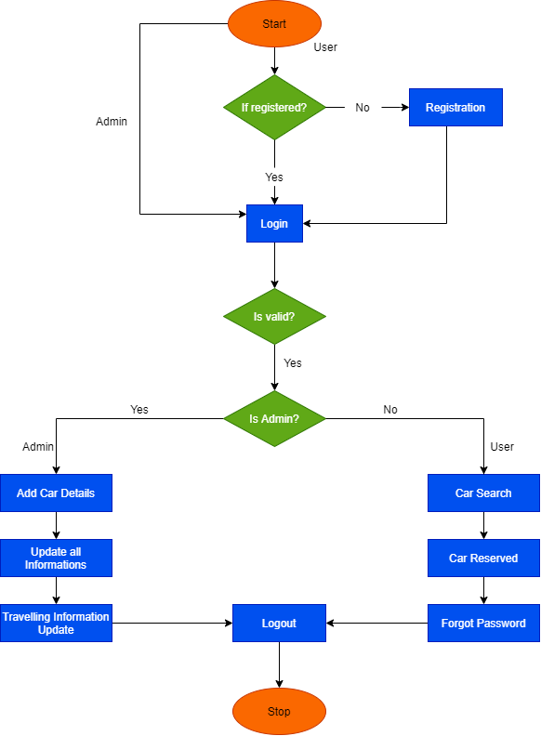
Flow Chart

Slide 18
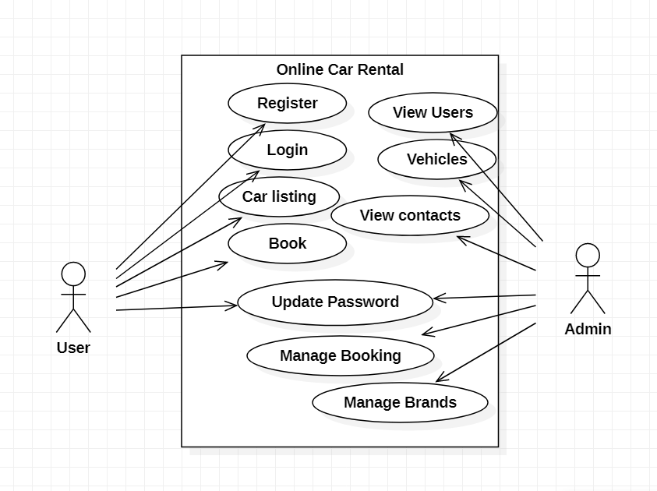
Use Case Diagram

Slide 19
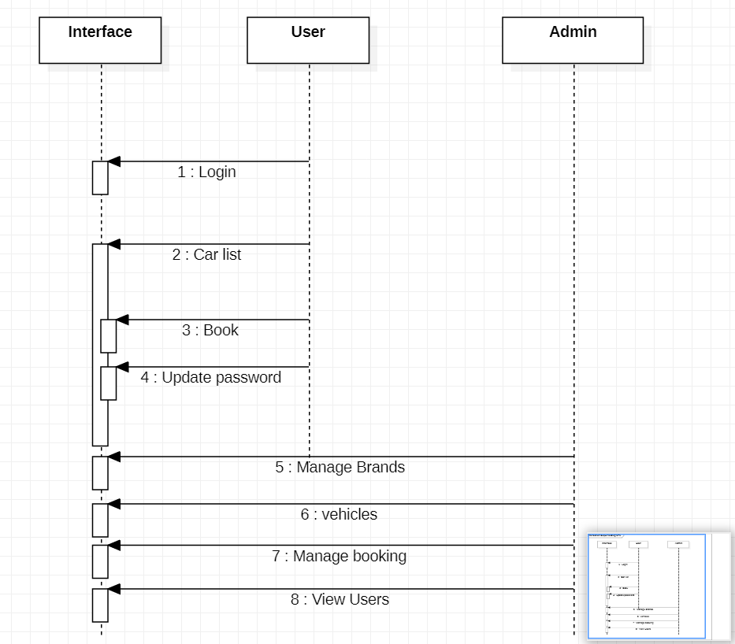
Sequence Diagram

Slide 20
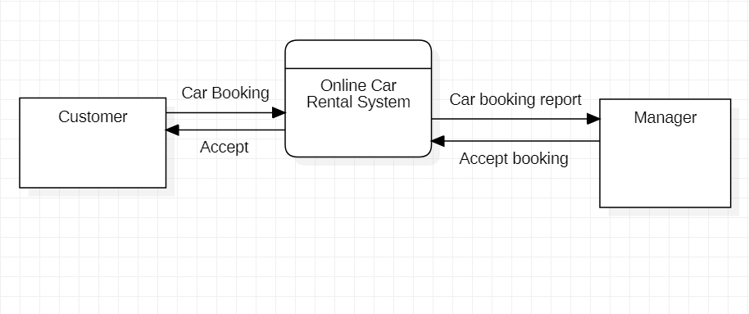
Data Flow Diagram

Slide 21
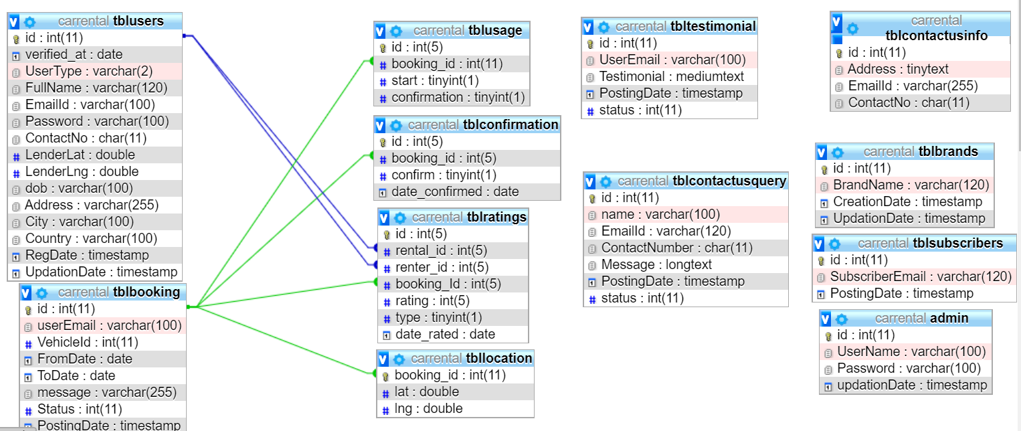
Entity Relationship Diagram

Slide 22
Snapshots(Admin)

Slide 23
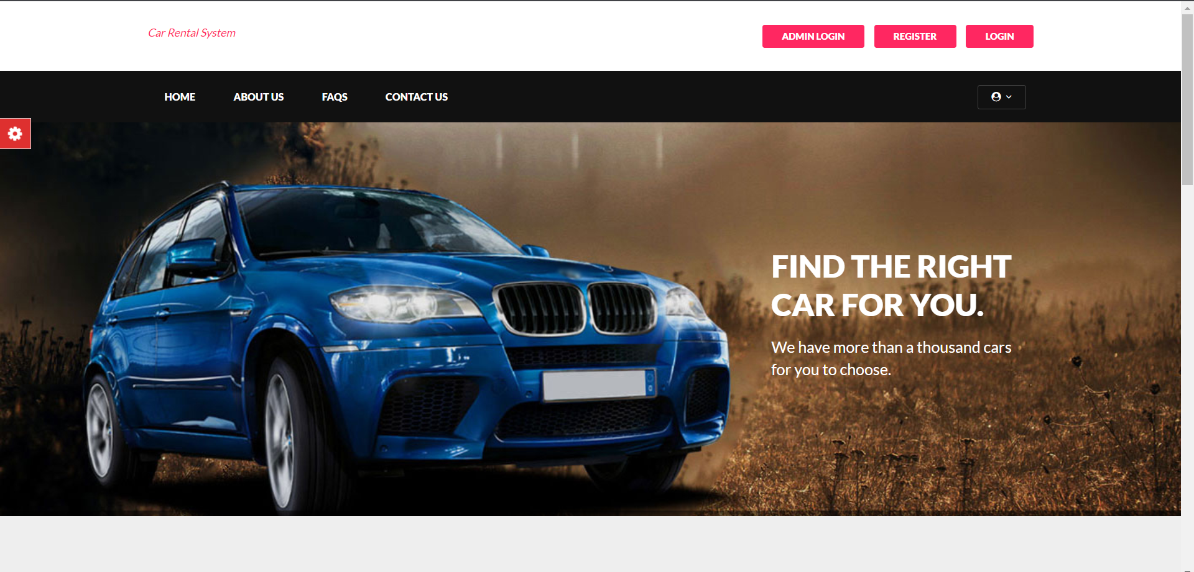
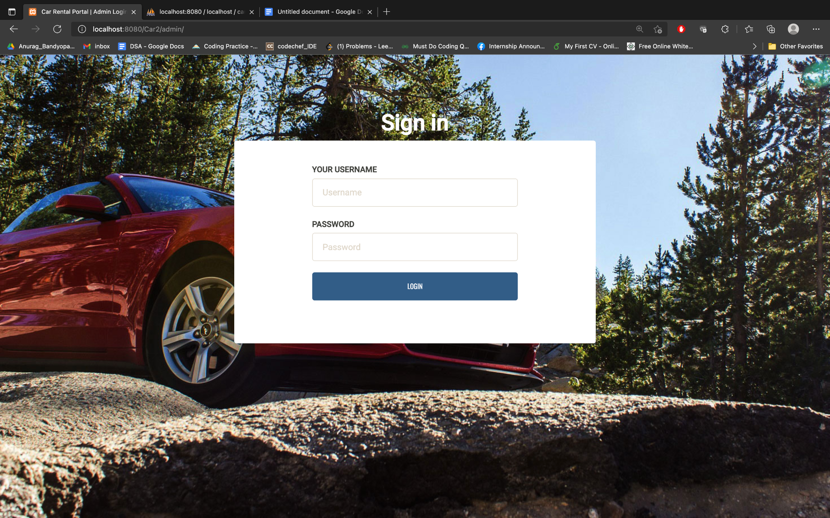
Home Page
Login Page

Slide 24
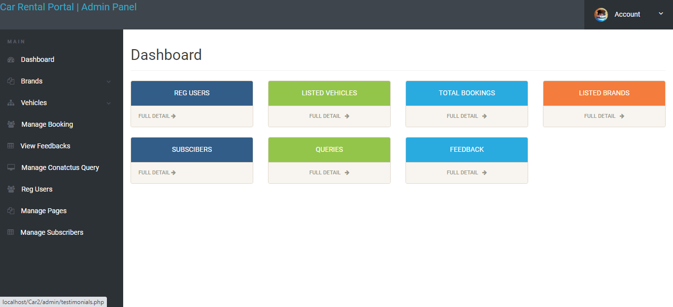
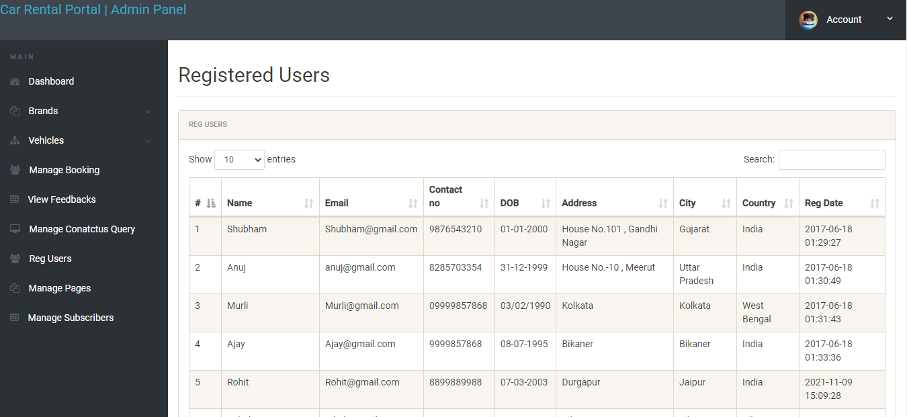
Admin Dashboard
View All Registered Users

Slide 25
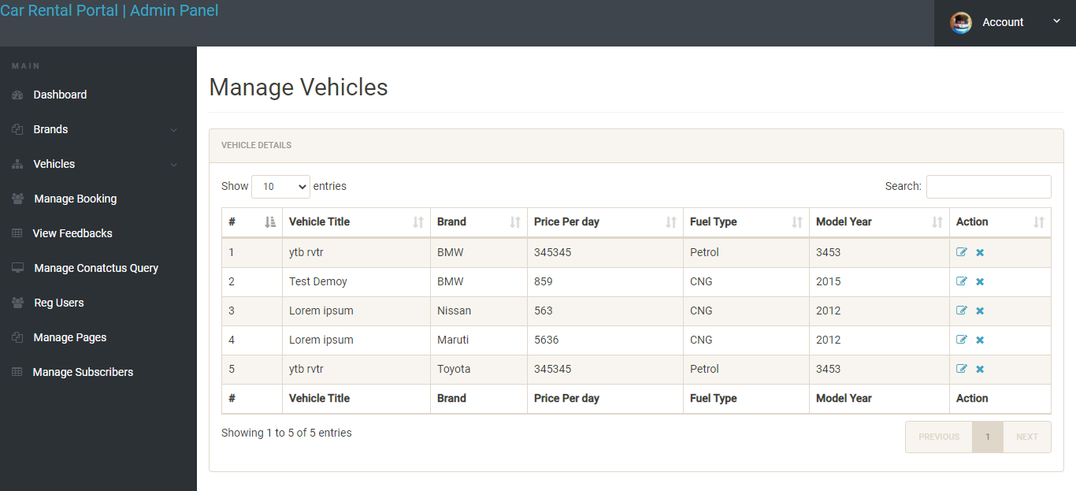
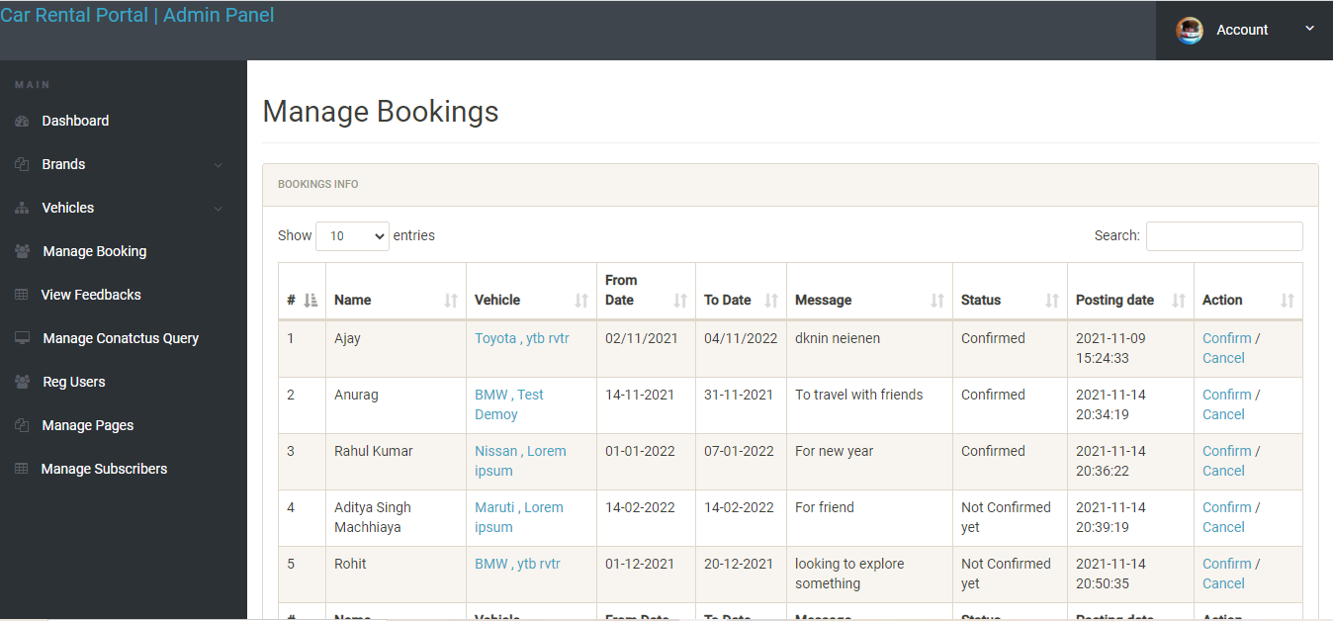
View All Listed Vehicles
View Manage Bookings

Slide 26
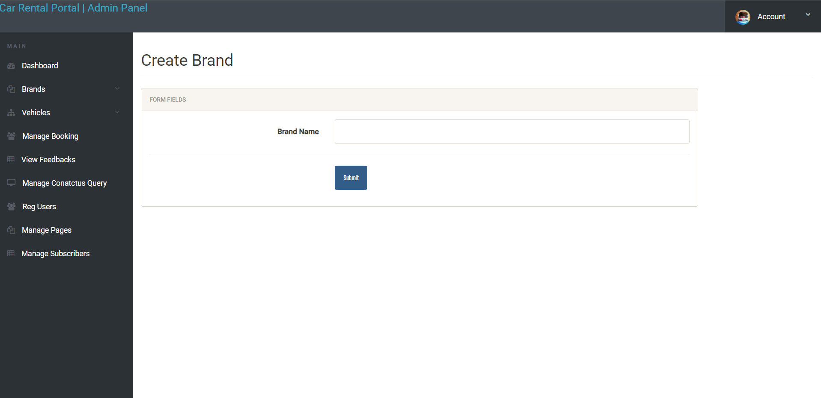
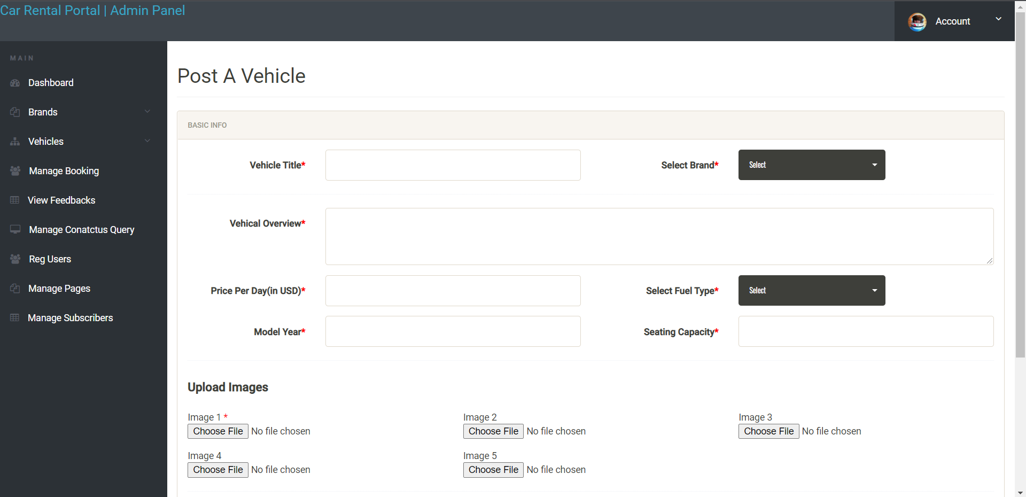
Create Brand Page
Post A Vehicle Page

Slide 27
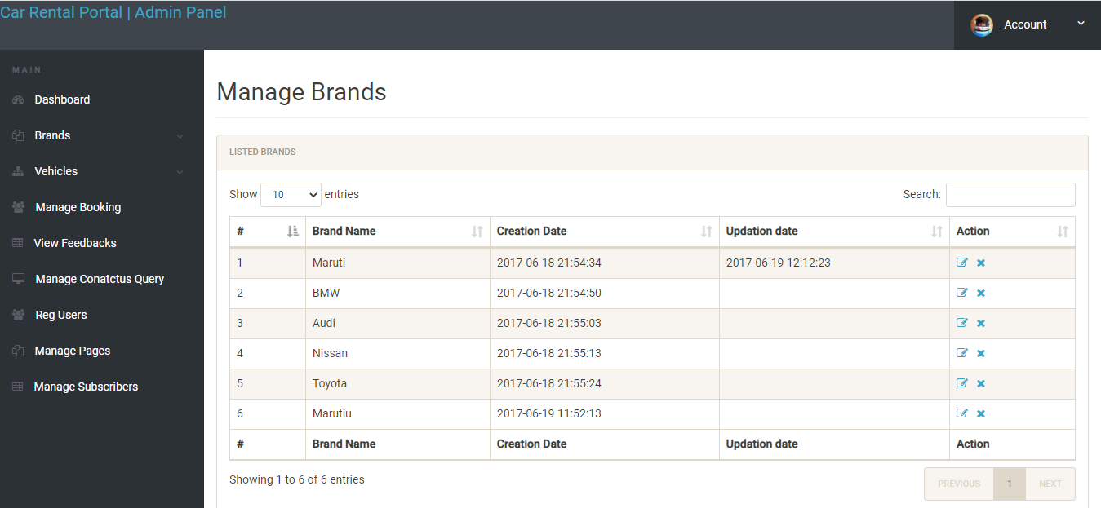
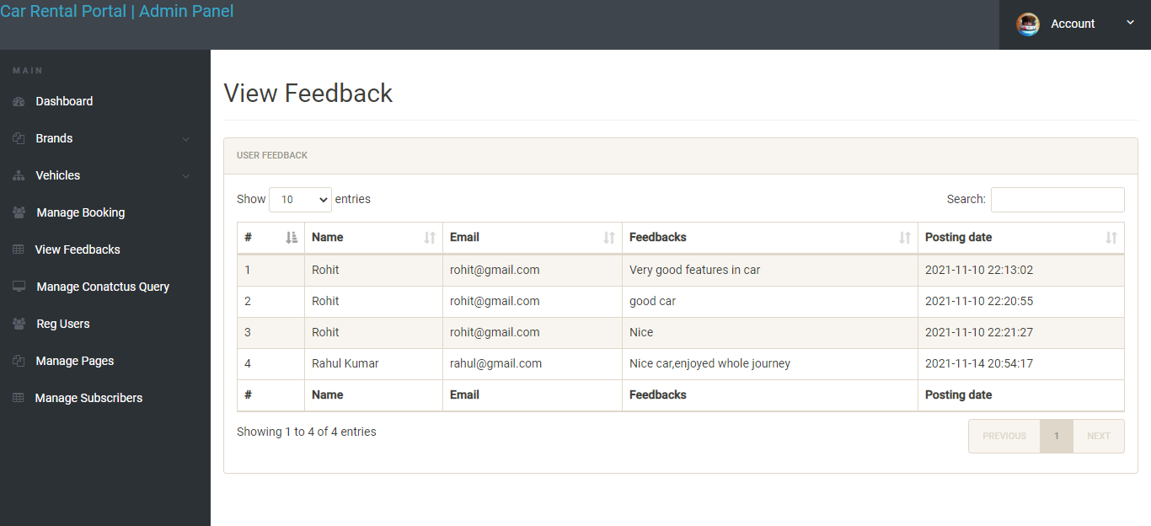
Manage Brands Page
View Feedback

Slide 28
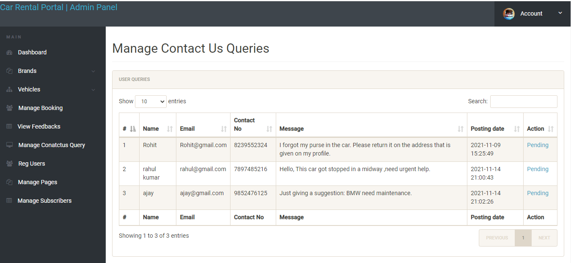
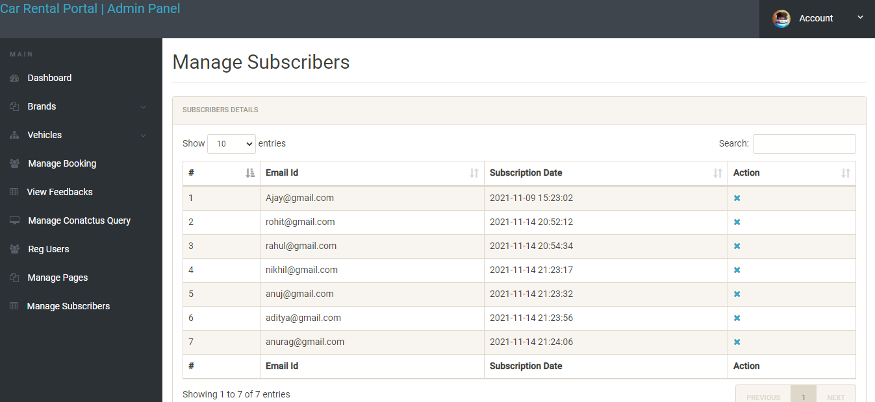
Manage Queries Page
Manage Subscribers Page

Slide 29
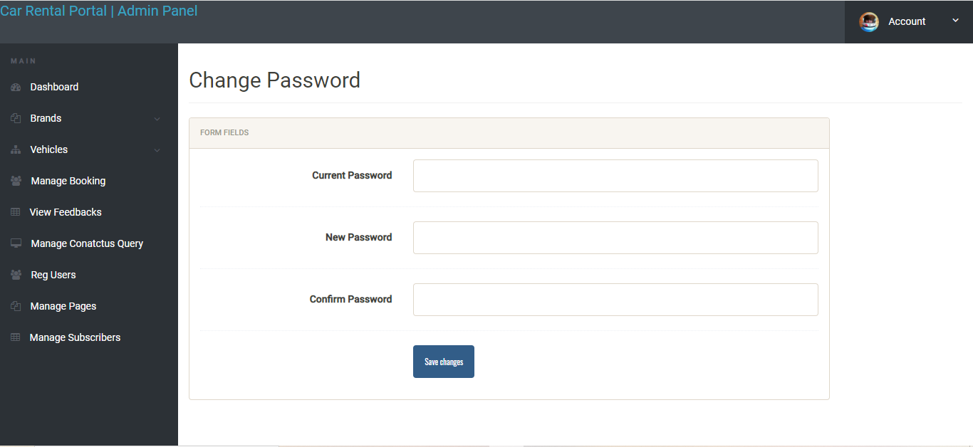
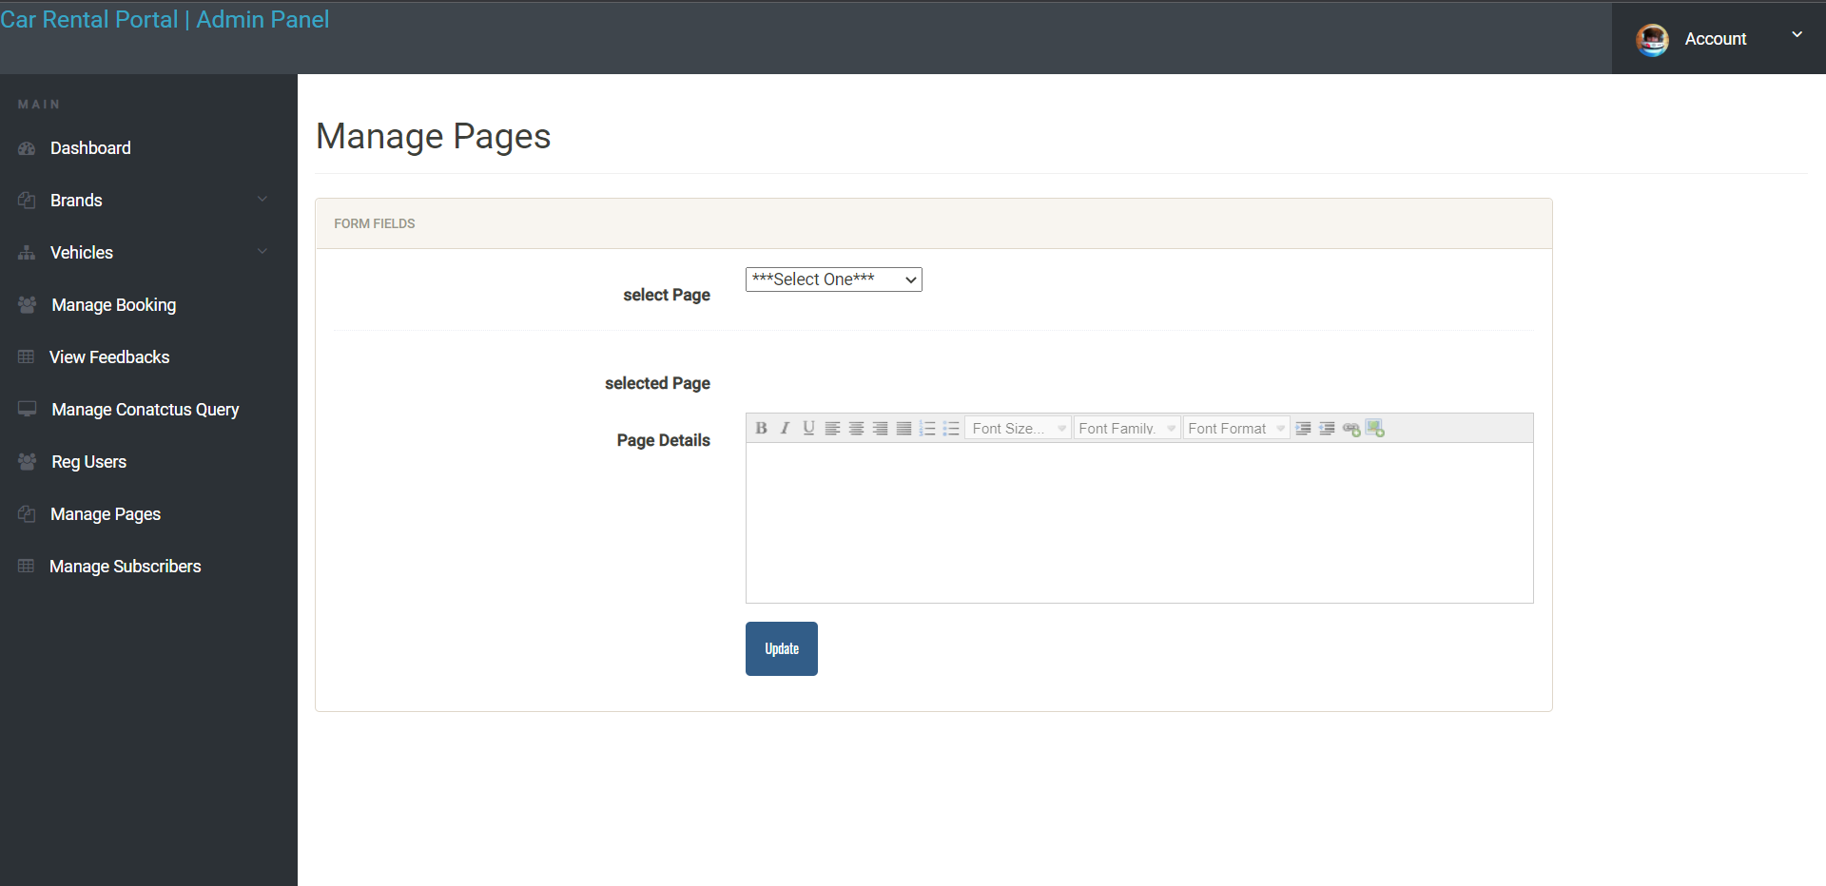
Change Password Page
Manage Pages

Slide 30
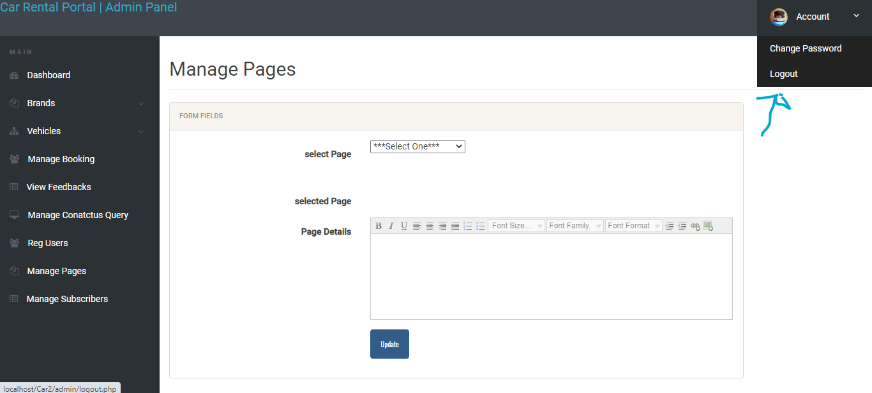
Sign Out

Slide 31
Snapshots(Guest)

Slide 32
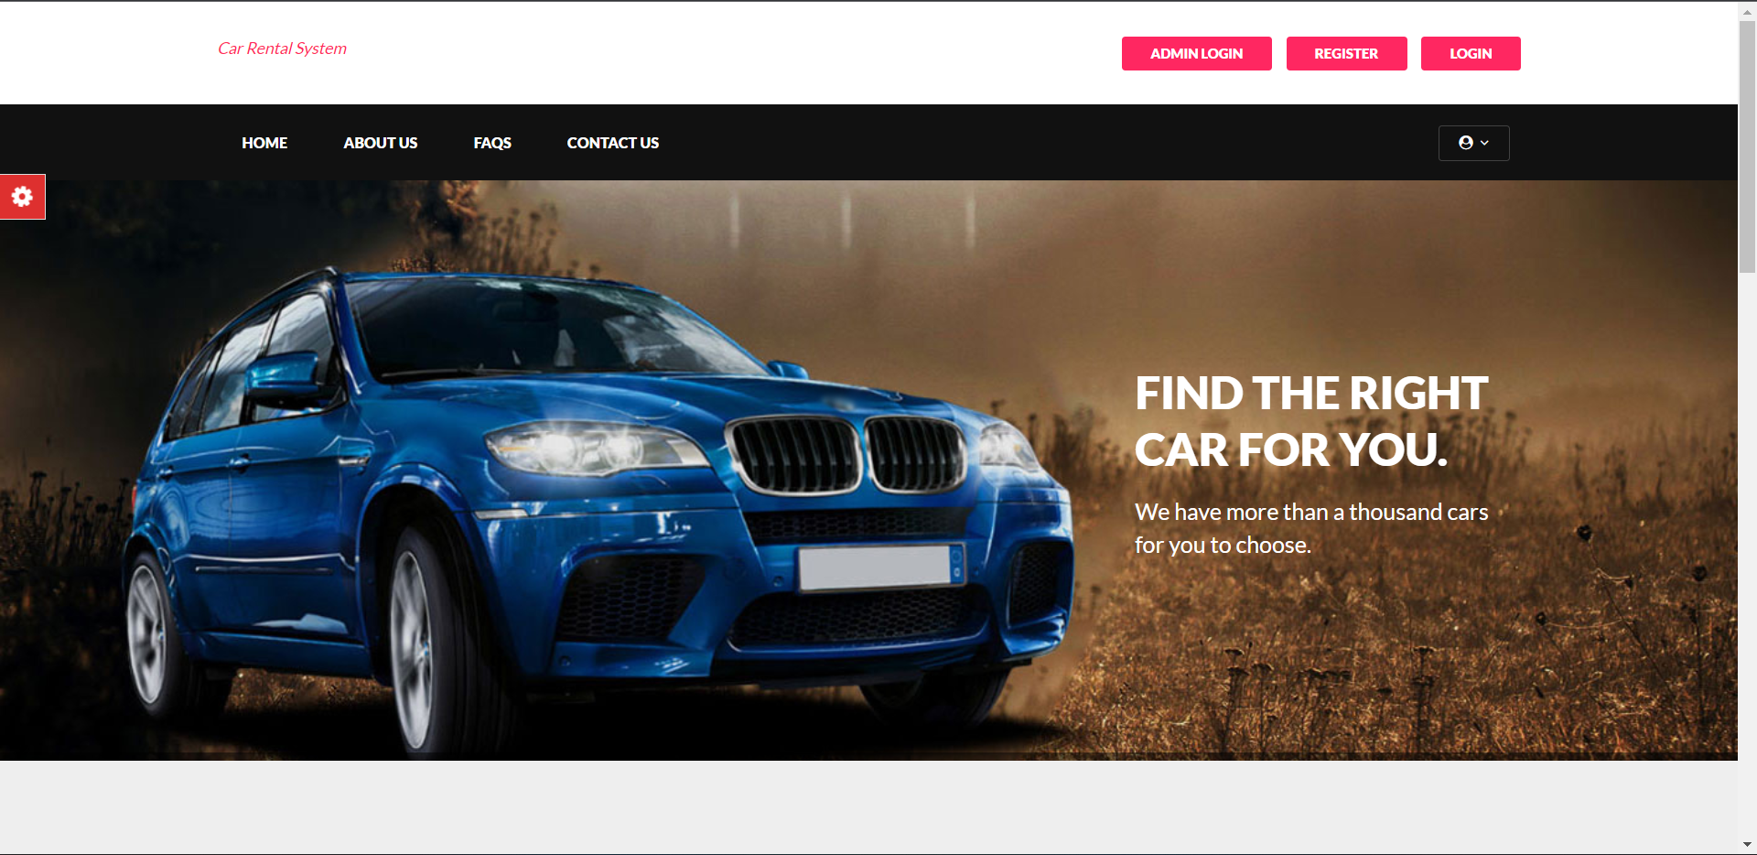
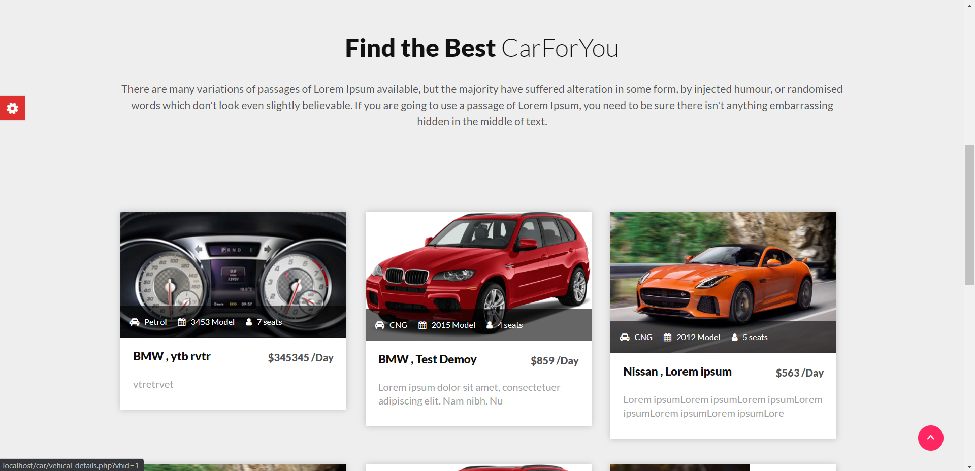
About Us Page
All Available Cars Page

Slide 33
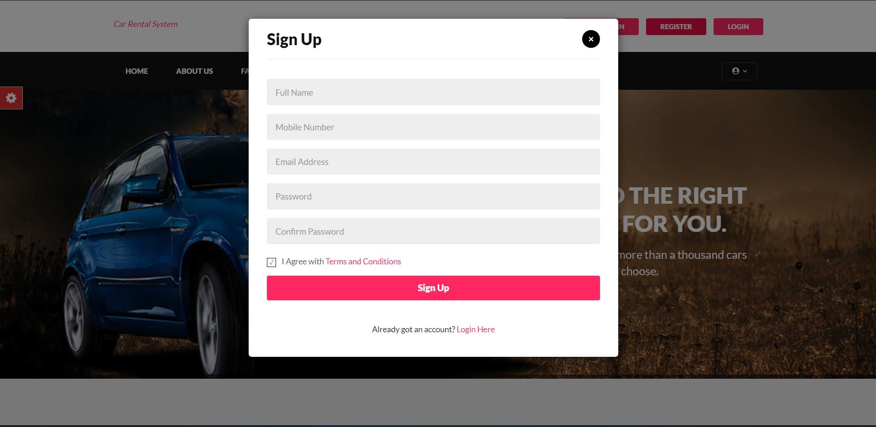
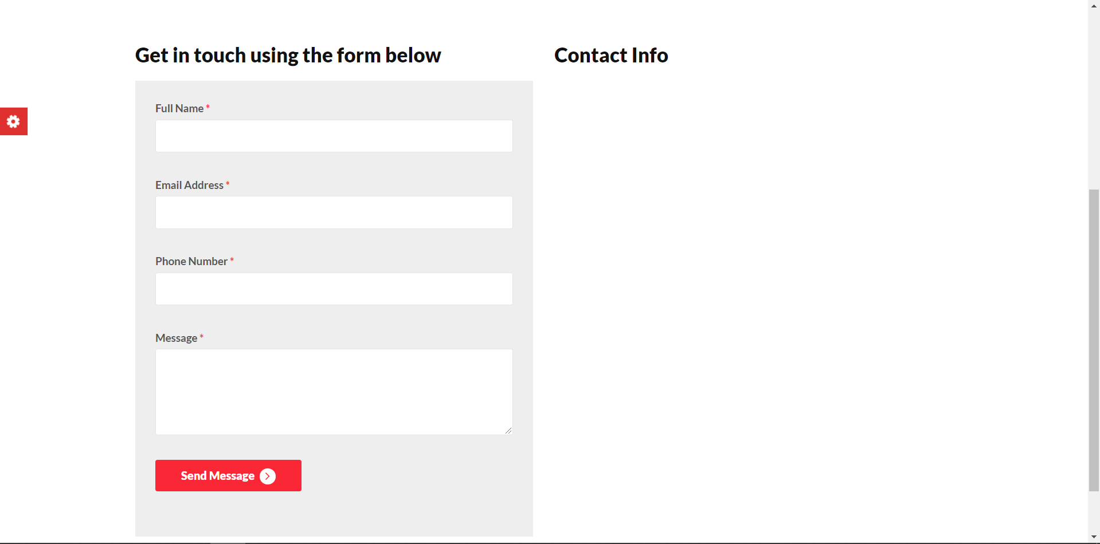
Registration Page
Contact Us Page

Slide 34
Snapshots(User)

Slide 35
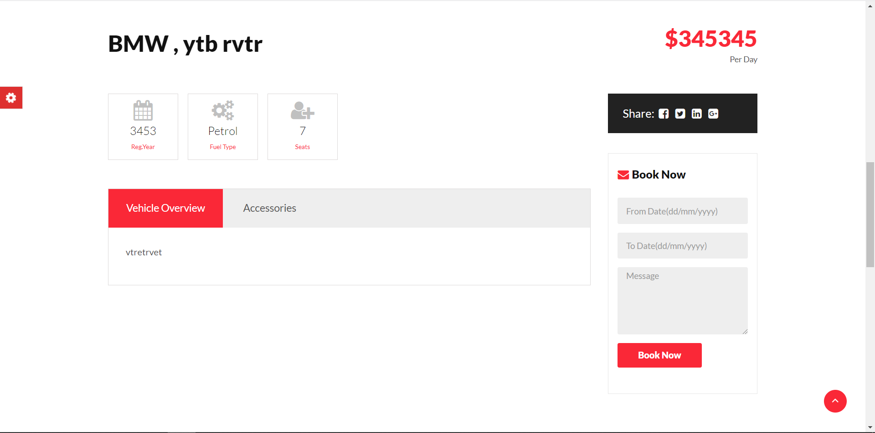
All Available Vehicles Page
Book Vehicles Page

Slide 36
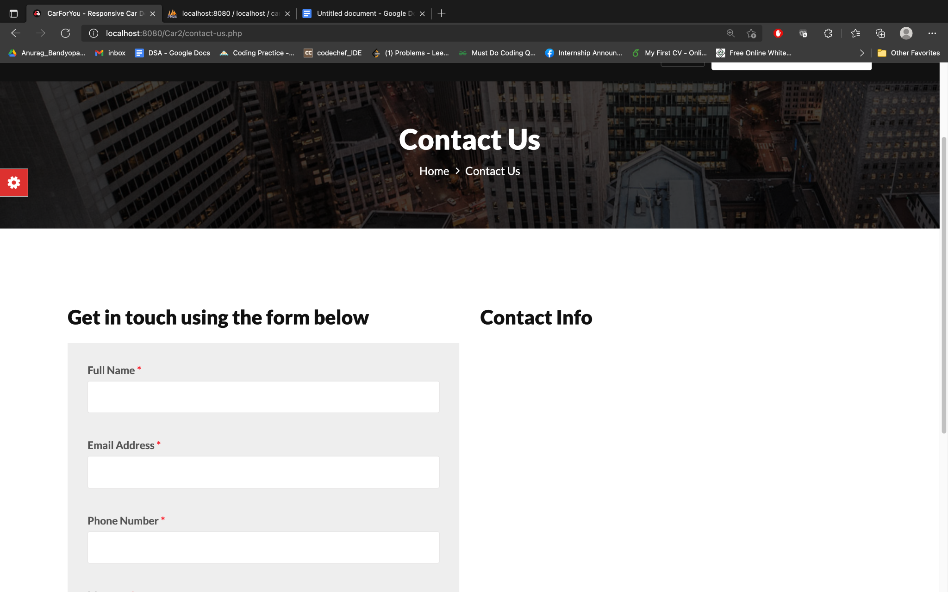
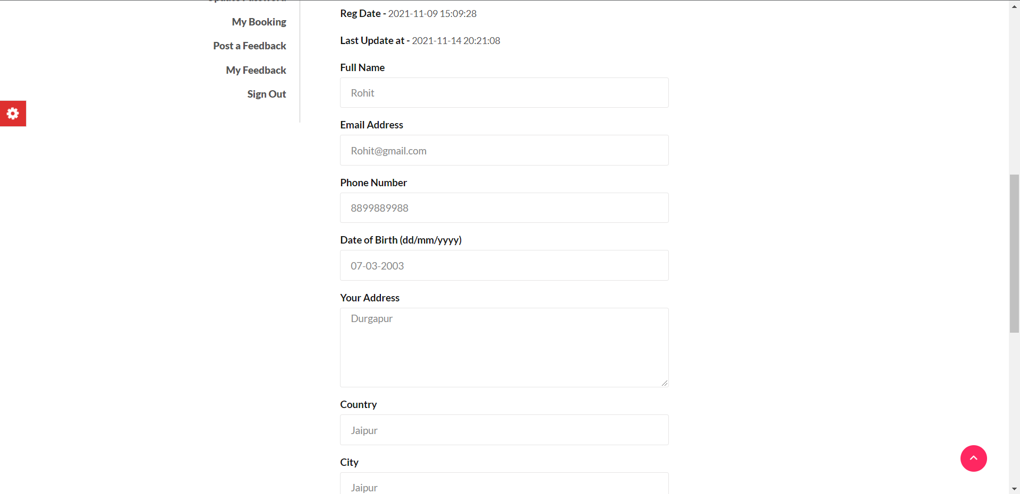
Queries Page
Update Profile Page

Slide 37
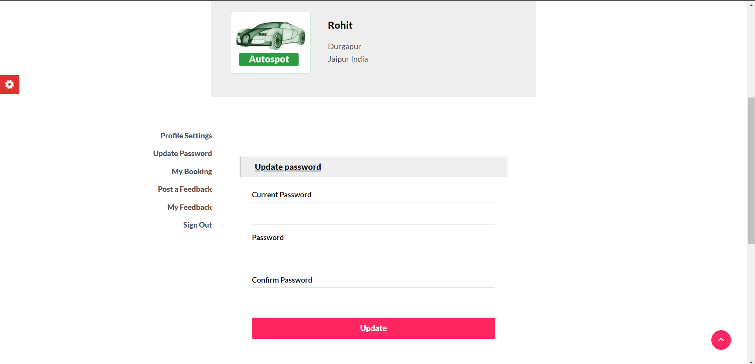
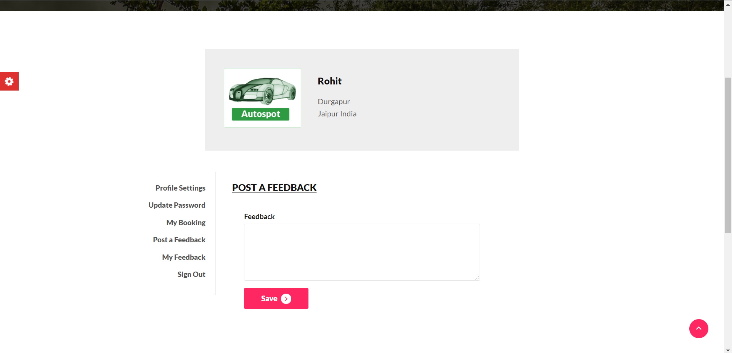
Update Password Page
Post Feedback Page

Slide 38
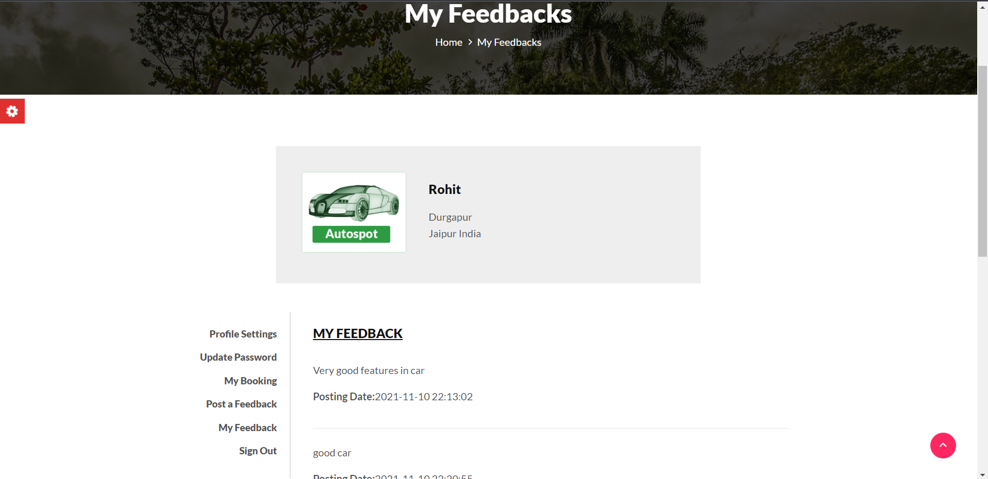
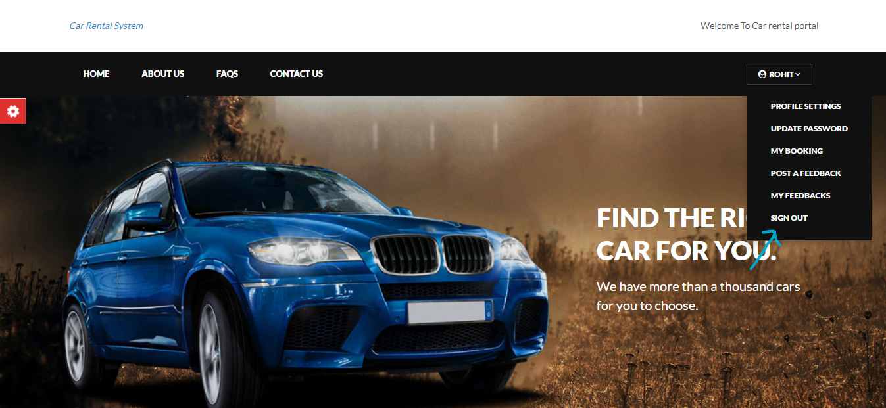
View Feedback Page
Sign Out

Slide 39
Non-functional Requirements
>>Responsiveness- The application should be responsive in order to respect real life time constraints. In this project we have ensured responsiveness by continually updating the information of users, vehicles, and booking details in the databases.
>>User friendliness- The application must be user-friendly and interactive.In this project we have used a simple, yet efficient User Interface to ensure that users from different age groups and backgrounds are able to understand and utilize the application with ease.

Slide 40
Non-functional Requirements
>>Consistency- The application should be consistent with its performance and results. For the same input data, the application should always give the same output results regardless of the location, operating system, input size and various other factors. Our application has been tested and proven to be consistent in this regards.

Slide 41
Non-functional Requirements
>>Security- Security is an essential part of any Software Engineering project. We must ensure that the credentials of the users and administrators are securely stored and that there are adequate security features in the system to prevent unwanted access to sensitive data.
>>Modifiability- Modifiability is the degree of ease at which changes can be made to a system, and the flexibility with which the system adapts to such changes. The application should be modifiable to a certain extent to serve the needs of organization if there are any changes in requirements. This application can be easily modified in order to serve the needs of different organizations, such as a smart office building, smart railway station, smart public museums, etc.

Slide 42
Advantages of Online Car Rental System
There are many advantages to Online Car Rental System:
User Satisfaction Level: This online system gives each and every service to customers at their doorstep. They can give their feed to a higher authority. They can book, visit, and enjoy the travel.
Time Efficiency: A new system provides features like time efficiency to show car details, user profiles, and whatever the customer will give the feedback to the admin. Customers do not need to waste two-three hours to get a car. They just need a smartphone and Car Renting app and get a car at their own place with few minutes.
Easy Inquiry: An inquiry is easily done by the user in the system. Inquiry is basically an automated and computerized task which really makes the inquiry process faster than previous.
Infrastructure: It is an online-based application. So, it does not require a big infrastructure. This business can be run running a room because our main dealing with customer is online.

Slide 43
Future Scope:
In near future, we are planning to hire cars daily basis. So that client can give their car to the customer on daily basis.
We are planning to add a new feature i.e. pay after the trip.
We are working to increase automation in the system to increase user experience greatly.
We are working on adding a new actor into the system - Car Owner. Thus give the option for car owners to register their vehicle directly into the system to be made available for renting.
We can add a chat with bot facility where guest users or registered users can interact with our bot and get the answers to their basic queries.

Slide 44
Source Code
Source Code
https://github.com/Rahulkumar-22/Car-Rental/

Slide 45
Thank You!

